Slide 1

Code Vulnerability Detection with Graph Algorithm and Learning
Dr. Yuede Ji
University of North Texas
Notes:
Dr. Lin

Slide 2
What is a Vulnerability?
A vulnerability is a weakness (usually a bug) that can be exploited by the attacker to perform unauthorized activities.
Integer overflow
Notes:
So, what is a vulnerability?
A vulnerability is a weakness (usually a bug) that can be exploited by the attacker to perform unauthorized activities.
This is an example code of square sum. It looks good. But if you look closely,
at line 7, the value of result could exceed the limit of 32-bit integer.
This would cause an integer overflow vulnerability, which can further be exploited to cause other serious security issues.

Slide 3
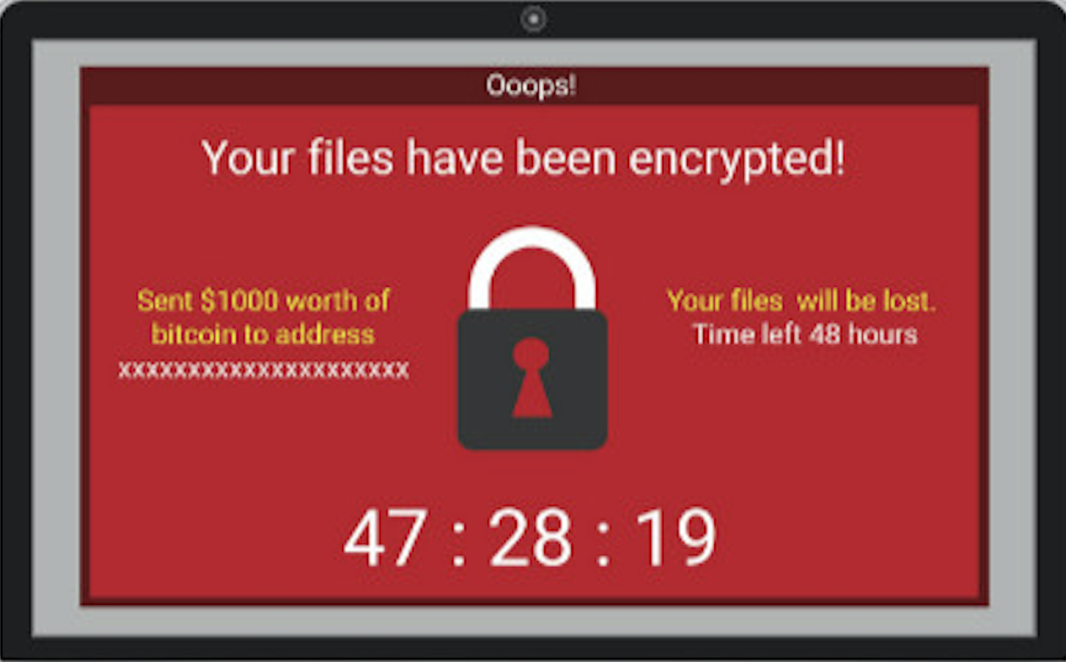




Why is a Vulnerability Dangerous?
A vulnerability can lead to various unauthorized activities:
Data leakage
Identify theft
Malware installation
…
Real-world impact
WannaCry ransomware infects 200,000 computers across 150 countries.
Exploits CVE-2017-0144 vulnerability in Windows’ Sever Message Block protocol.
Malicious input
Victim computer
Attacker
Notes:
1. General
2. Example
3. WannaCry
You might still remember the WannaCry ransomware. It infects 200,000 computers across 150 countries.
It actually exploits a vulnerability in Windows’ Sever Message Block protocol.

Slide 4
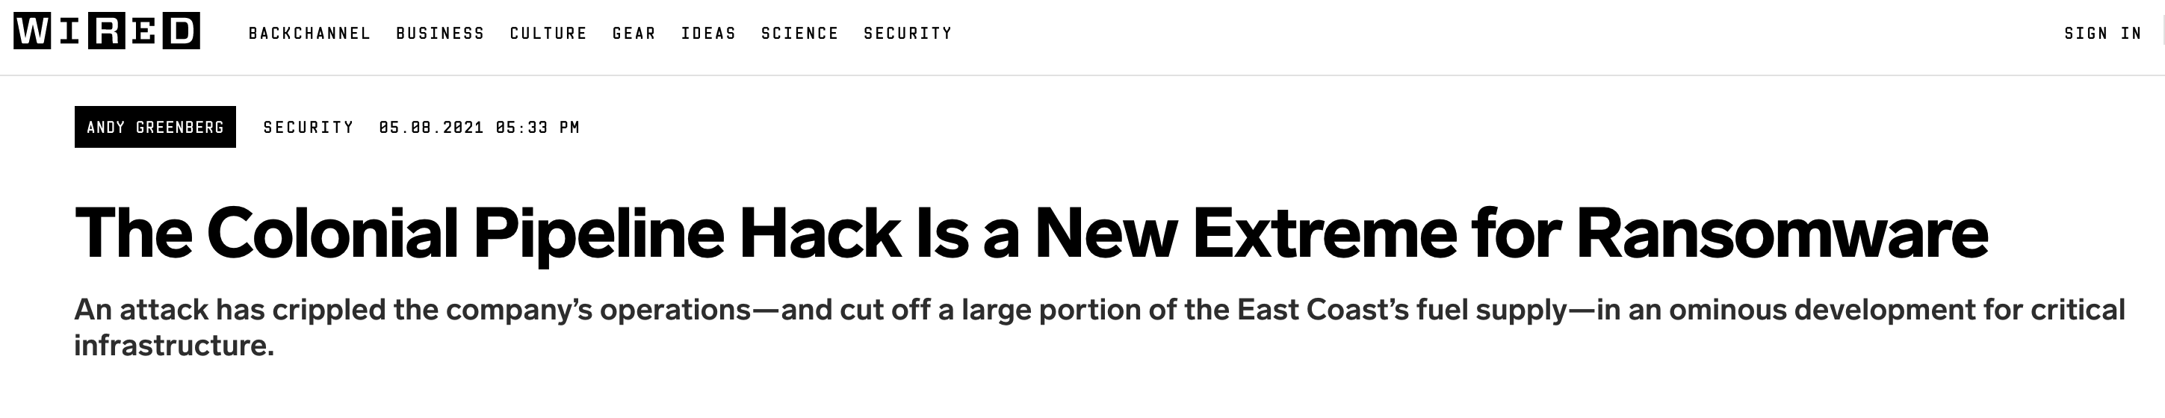
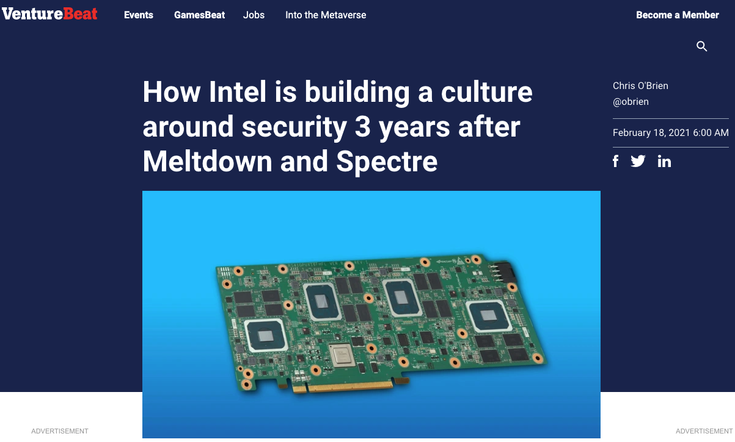

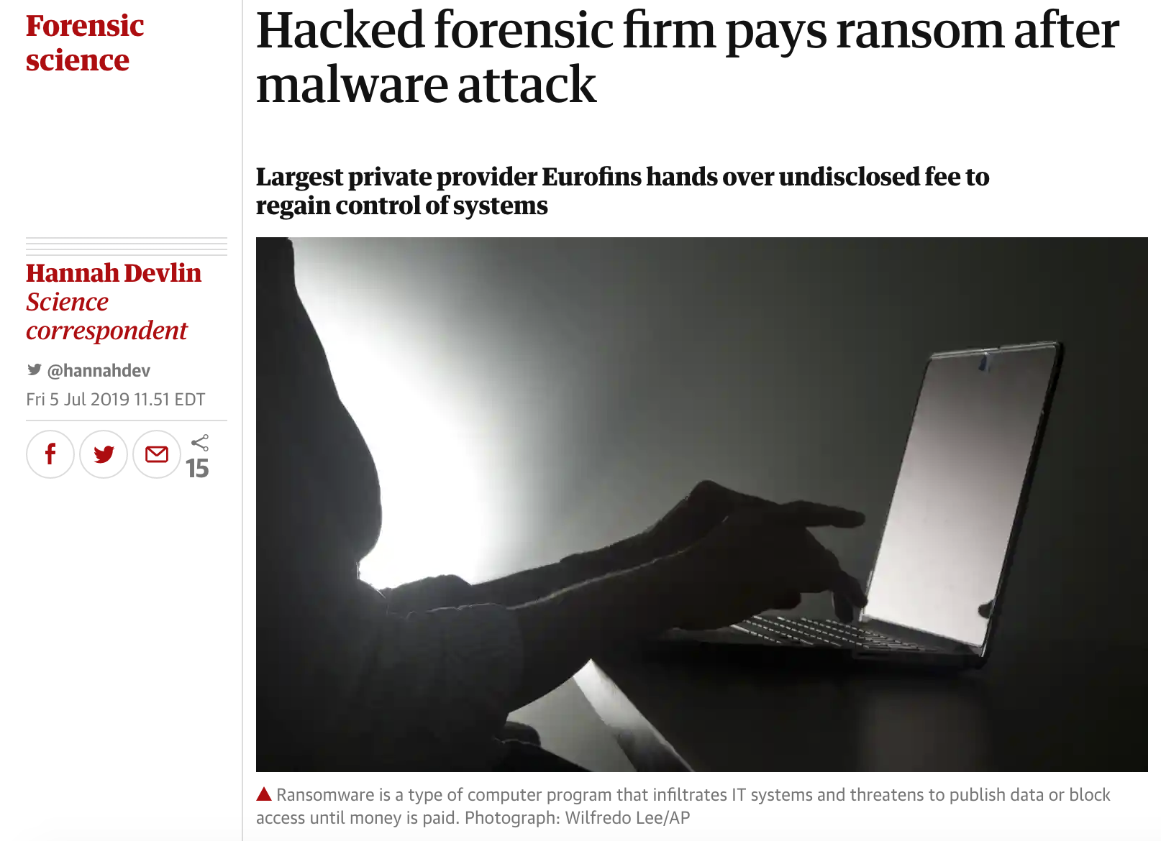
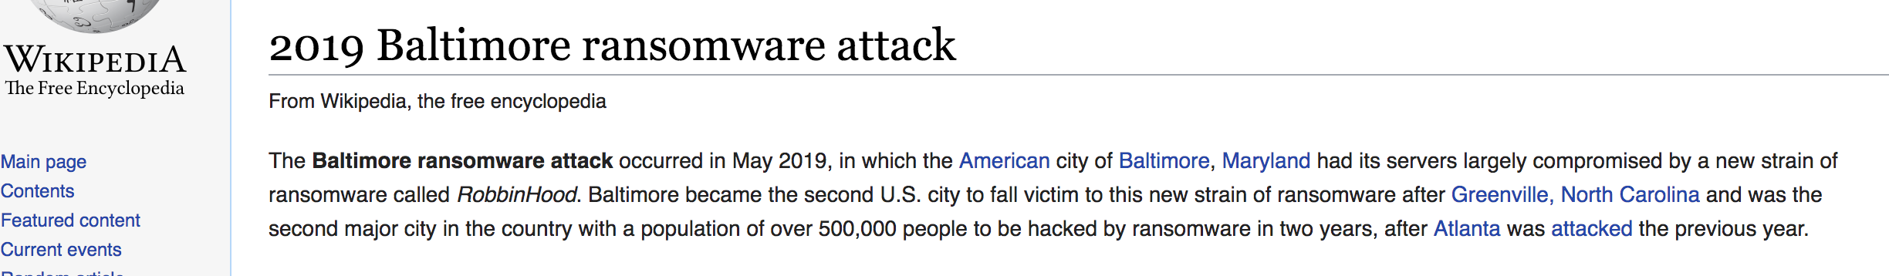
Vulnerability Detection is Important!
Notes:
I believe you have seen various vulnerability-related incidents from the news. They have not only caused harms to the victims but also greatly affected our daily life.
For example, the attack on the colonial pipeline in 2021 has caused gas supplement shortage. The gas price has increased dramatically for the east coast of US.
There are many other attacks as well,
such as 2019 Baltimore ransomware attack,
attack on Georgia Courts,
attack on security companies,
and the Meltdown and Spectre vulnerabilities in Intel chips.
Therefore, detecting the vulnerabilities as early as possible is critically important.

Slide 5

Graph in Real Applications
Application | Graph | Algorithm | Usage
Navigation
Src
1
Dst
c
1
b
c
1
b
Road map graph
Shortest path
a
f
a
1
1
f
2
d
2
Notes:
The next question is, what is a graph? And how can it help for vulnerability detection?
A graph is made up of vertex and edge. It is a natural data representation for many real-world applications.
For example, in the route map, taking a crossing as a vertex and the road between two crossings as an edge,
we can build a road map graph. With that, the shortest path algorithm can help for navigation. In this example graph, if we wanna go from place a to f,
the shortest path algorithm can help to find this colored path for us.

Slide 6
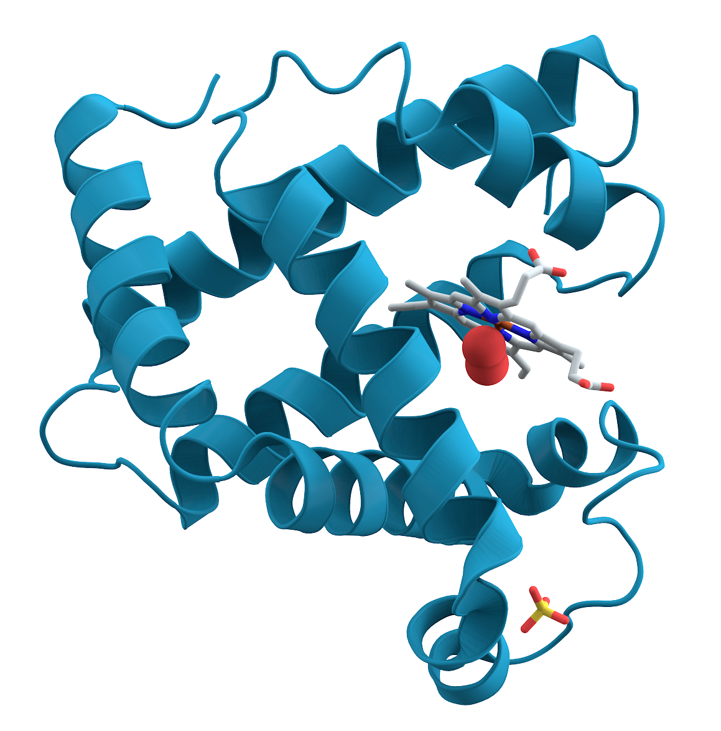
Graph in Real Applications
Application | Graph | Algorithm | Usage
Navigation | Road map graph | Shortest path
Key connector protein identification
Src
1
Dst
c
1
b
c
1
b
a
f
a
1
1
f
2
d
2
a
Key
d
e
Protein-protein interaction graph
Betweenness centrality
c
f
c
b
g
h
Notes:
In protein analysis, the proteins are known to interact with each other to act their functions.
With that, we can build a protein-protein interaction graph.
Using the centrality algorithm, such as betweenness centrality, we can identify the key connector protein.
In this example graph,
protein c would be identified as the protein with the most connections.

Slide 7

Graph in Real Applications
Application | Graph | Algorithm | Usage
Navigation | Road map graph | Shortest path
Key connector protein identification | Protein-protein interaction graph | Betweenness centrality
Friend recommendation
Src
1
Dst
c
1
b
c
1
b
a
f
a
1
1
f
2
d
2
a
Key
d
e
c
f
c
b
g
h
a
Friendship graph
Triangle completing
c
Mutual friend
Friend?
c
b
Notes:
In social network, we can build a friendship graph.
On this graph, the triangle completing algorithm can help to recommend friends.
In this triangle, users a and b share a mutual friend c. Then it is possible that a and b know each other.

Slide 8
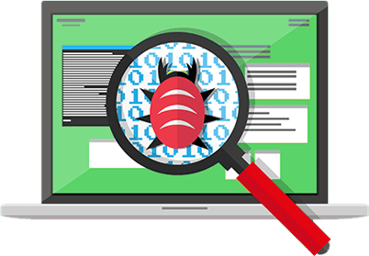
Graph in Real Applications
Application | Graph | Algorithm | Usage
Navigation | Road map graph | Shortest path
Key connector protein identification | Protein-protein interaction graph | Betweenness centrality
Friend recommendation | Friendship graph | Triangle completing
Vulnerability detection
Src
1
Dst
c
1
b
c
1
b
a
f
a
1
1
f
2
d
2
a
Key
d
e
c
f
c
b
g
h
a
c
Mutual friend
Friend?
c
b
Alarm!
h
b
a
b
a
Control flow graph
Subgraph isomorphism
b
c
c
Vulnerability template
e
f
Unknown software
Notes:
In vulnerability detection, the code is usually represented as a control flow graph.
Given an unknown software,
if it matches to a known vulnerability template, then it is possible to have the same vulnerability. This can be done with the help of subgraph isomorphism.

Slide 9

Challenge: How Can Graph Help Vulnerability Detection?
Q2: How to formalize the problem with graph?
Q3: What graphs should we build?
Q1: What is the research problem?
!?
…
Q4: Can graph better represent the data?
Q7: Does it work better than conventional solutions?
Q5: What are the properties of these graphs?
Q6: What graph algorithms should we use?
Notes:
The major challenge of applying graph to vulnerability detection is, how can it help?
We need to answer a bunch of questions.
Such as
...
Basically, we need to deeply understand code vulnerability detection, instead of blindly building graphs and applying graph algorithms.

Slide 10
Agenda
Background
Research Summary
Contribution #1: Binary code vulnerability detection
Contribution #2: Android firmware vulnerability detection
Notes:
So far, I have covered the background.

Slide 11
Agenda
Background
Research Summary
Contribution #1: Binary code vulnerability detection
Contribution #2: Android firmware vulnerability detection
Notes:
Now, let me summarize my research.

Slide 12
Applying Graph to Cybersecurity
Research Questions:
Q1: How to formalize the cybersecurity problem to a graph problem?
Q2: How to effectively and efficiently solve the graph problem?
Domain | Project | Graph | Graph Algorithms
Code Vulnerability Detection | Illuminati [EuroS&P’22] | Control + Data Flow Graph | Graph Neural Network
Code Vulnerability Detection | DEFInit [USENIX Security’21] | Dependency + Control Flow Graph | Graph Traversal
 | BugGraph [AsiaCCS’21] | Control Flow Graph | Graph Triplet-Loss Network
 | Vestige [ACNS’21] | Function Call Graph | Graph Attention Network
Notes:
We try to apply graph to various cybersecurity applications. To achieve that, we aim to answer two research questions.
The first one is How to formalize the cybersecurity problem to a graph problem?
The second one is How to effectively and efficiently solve the graph problem?
With that, we deeply studied the code vulnerability detection problem. We have built four systems with graph and graph algorithms.
The first one is Illuminati, it detects source code vulnerability by using control flow graph and data flow graph. We used graph neural networks.
The second one is DEFInit, it scans Android firmware and identifies potential vulnerabilities related to system services. We built dependency graph and control flow graph.
The third one is BugGraph, it detects binary code vulnerability by building control flow graphs and applying graph triplet-loss network.
The fourth one is Vestige, it identifies binary code compilation provenance by building function call graph and applying graph attention network.

Slide 13
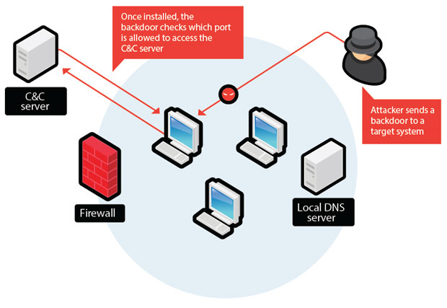
Applying Graph to Cybersecurity
Research Questions:
Q1: How to formalize the cybersecurity problem to a graph problem?
Q2: How to effectively and efficiently solve the graph problem?
Domain | Project | Graph | Graph Algorithms
Code Vulnerability Detection | Illuminati [EuroS&P’22] | Control + Data Flow Graph | Graph Neural Network
Code Vulnerability Detection | DEFInit [USENIX Security’21] | Dependency + Control Flow Graph | Graph Traversal
 | BugGraph [AsiaCCS’21] | Control Flow Graph | Graph Triplet-Loss Network
 | Vestige [ACNS’21] | Function Call Graph | Graph Attention Network
Network Threat Detection | Malicious Host Detection [ICC’22] | Host Communication + Process Alive Graph | NestedGNN (Our Proposed Method)
 | Lateral Movement Detection [RAID’20] | Authentication Graph | Unsupervised Node Embedding
 | Malicious URL Detection [NPC’14 Best Paper] | Social Network User Graph | Local Clustering Coefficient
Notes:
In the meantime, we have also applied graph algorithms to network threat detection. So far, we have studied malicious host detection and lateral movement detection in Enterprise network, and malicious URL detection in social network.
In the following, I will deeply explain our efforts on code vulnerability detection by discussing two works, DEFInit and BugGraph.

Slide 14
Agenda
Background
Research Summary
Contribution #1: Binary code vulnerability detection
Contribution #2: Android firmware vulnerability detection
Notes:
Now, let's first look at BugGraph for binary code vulnerability detection.

Slide 15

Binary Code Vulnerability Detection
BugGraph: Differentiating Source-Binary Code Similarity with Graph Triplet-Loss Network
Domain | Project | Graph | Graph Algorithms
Code Vulnerability Detection | BugGraph | Control Flow Graph | Graph Triplet-Loss Network
Notes:
In this part, I will present how to apply graph and graph algorithms to binary code vulnerability detection.

Slide 16
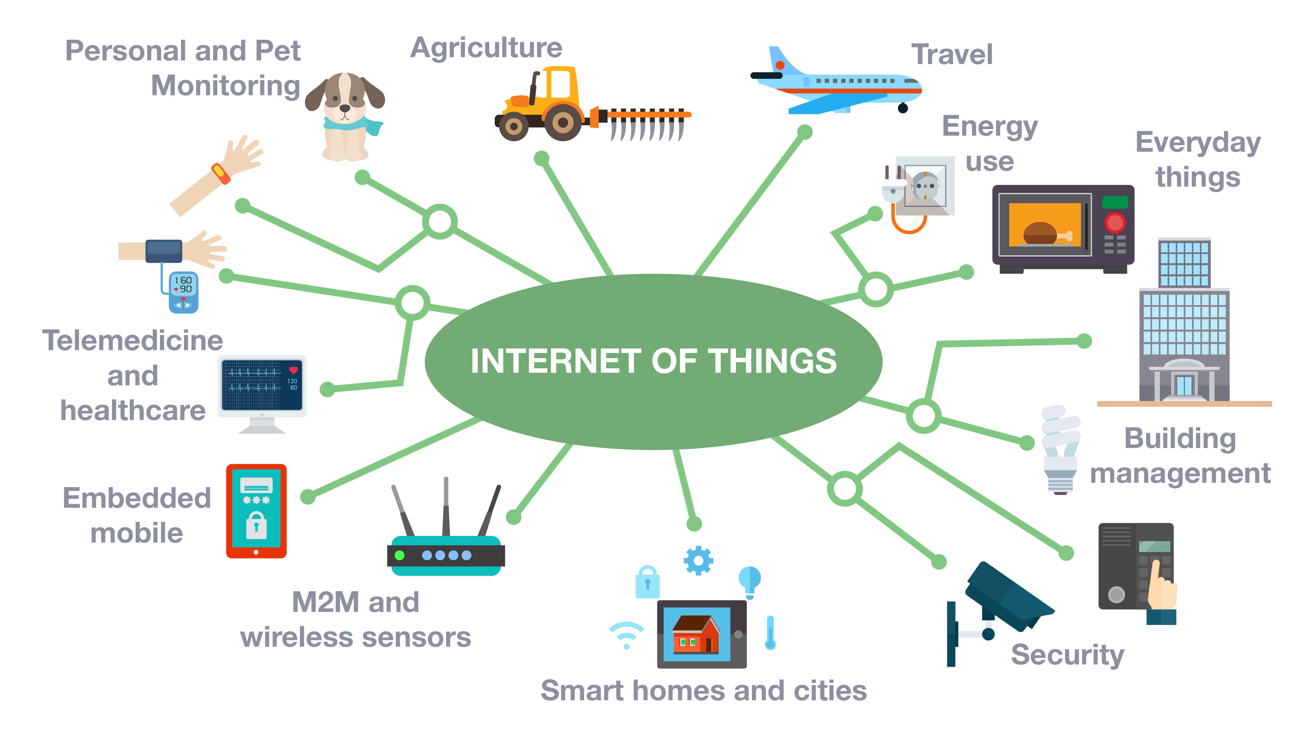
Binary Code is Prevalent
Software vendors usually do not share the source code.
A significant number of binaries are running in the wild, e.g., firmware of IoT devices.
Num. of Connected IoT Devices from 2015 to 2025
Count in billion
75 Billion
40 Billion
16
source: statista
Notes:
Binary code is prevalent as the software vendors usually do not share the source code.
A significant number of binaries are running in the wild, e.g., the firmware of IoT devices.
This figure shows the Num. of Connected IoT Devices from 2015 to 2025. The x-axis shows the year, and y-axis shows the count in billion.
By this year, it is expected to reach 40 billion.
And it is estimated to reach 75 billion by 2025.

Slide 17
Research Problem
Motivation
Open-source libraries are widely used in binaries, e.g., OpenSSL.
Up to 80% of the binaries in IoT firmware still use third-party libraries with already discovered vulnerabilities.
Research Problem
How to scalably check whether the already discovered vulnerabilities (source code) still exist in the unknow binary code.
[NDSS’13] Cui, Ang, Michael Costello, and Salvatore Stolfo. "When firmware modifications attack: A case study of embedded exploitation." (2013). In NDSS.
Notes:
Although the binary code is closed source, the open-source libraries are widely used in binaries, e.g., OpenSSL.
And up to 80% of the binaries in IoT firmware still use third-party libraries with already discovered vulnerabilities.
So, the research problem we are focusing on is how to scalably check whether the already discovered vulnerabilities (reprensted as source code) still exist in the unknown binary code.

Slide 18
Similarity-Based Solution
Source-Binary Code Similarity for Vulnerability Detection
If an unknown code is similar to a discovered vulnerability template, then the unknown code is potentially to have the same vulnerability.
Challenge:
The source and binary code are not in a canonicalized form.
Existing Solution:
Transform the problem to binary code similarity detection by compiling the source code to a binary.
101010011100000001010010100011001010101010010101010101001010100101010100
101010011100000001010010100011001010101010010101010101001010100101010100
Similar?
Unknown binary code
Vulnerability template
Notes:
An efficient type of solutions is similarity-based.
It is motivated by the observation, that If an unknown code is similar to a discovered vulnerability code, then the unknown code is potentially to have the same vulnerability.
With that, the problem of vulnerability detection has become the problem of source-binary code similarity detection.
It is challenging to directly compare the source and binary code because they are not in a canonicalized form.
To solve that, the previous works would compile the source code to a binary, usually with a randomly picked compilation option.
And then, the problem becomes binary code similarity detection.
However, this kind of solutions face two major challenges.

Slide 19
Challenge #1: Low Accuracy
Low accuracy due to many combinations of compiling options
Compiler: GCC (200+ versions), LLVM (50+ versions), etc.
Optimization level: O-{0, 1, 2, 3, s, fast, g}
Architecture: x86, ARM, MIPS, etc.
Source code
Front end
Middle end
Back end
Binary code
Lexical analysis
IR analysis
Machine
dependent
optimization
Intermediate Representation
(IR)
111010001100
int f(){
...
Optimized IR
BIN
SRC
Syntax analysis
Machine
independent
optimization
Semantic analysis
Code generation
Compiler (family, version)
Optimization level
Architecture
Notes:
The first challenge is low accuracy due to many combinations of compiling options.
Let’s look at how the binary code is generated. Given the source code, a compiler would apply front end analysis and generate the compiler specific intermediate representation. Next, it will apply middle end analysis and optimize the intermediate representation. Later, it will use back-end analysis and generate machine-specific binary code.
So, in this process, the compiler, optimization level, and architecture would all affect how the binary code is generated.
There are so many combinations of compiling options, for example, the GCC compiler has over 200 versions and the LLVM compiler has over 50 versions.
And each compiler version has at least four optimization levels.
Also, there are various architectures, including x86, ARM, MIPs, and others. So, two randomly picked binary codes could have very different compiling options. And this would dramatically lower the accuracy.

Slide 20
Challenge #1: Low Accuracy
Low accuracy due to many combinations of compiling options
Compiler: GCC (204 versions), LLVM (55 versions), etc.
Optimization level: O-{0, 1, 2, 3, s, fast, g}
Architecture: x86, ARM, MIPS, etc.
lea ecx, [rdi-1]
mov edx, ecx
shr edx, 2
lea esi, ds:0[rdx*4]
test esi, esi
jz loc_4007F8
x86-LLVM-3.3-O1
Example source code
x64-GCC-4.8.5-O3
Notes:
Let me explain why would this lower the accuracy with the square sum function example.
using compiler LLVM-3.3 with optimization level O1 on x86 architecture, we will get a disassembled binary code with its control flow like this.
But if we use GCC-4.8.5 with optimization level O3 on x64 architecture, we will get a disassembled binary code like this. The assembly codes are ignored because the code size is too big.
In this case, both the code size and control flows are greatly changed,
mainly because the optimization level O3 applies loop related optimization techniques, such as, loop unrolling and tree vectorization.
It is quite challenging to find these two disassembly codes similar no matter from instructions or code structures.

Slide 21
Challenge #2: Low Coverage of Similar Code Types
Three types of similar code
Type-1: Difference in the white space, blank line, layout, and comment.
Type-2: Difference in identifiers, literals, and data types.
Type-3: Difference in statements, including changed, added, or deleted.
Low coverage as prior works only focus on Type-1/2 similar code
Type-3 contributed to over 50% of all vulnerabilities discovered by code similarity [Islam et al. ESEM’17]
Example source code
Type-1
Type-2
Type-3
Notes:
The second challenge is from the source code level. There are three types of similar code.
By definition, type-1 has Difference in the white space, blank line, layout, and comment.
type-2 has difference in identifiers, literals, and data types.
type-3 has difference in statements, including changed, added, or deleted.
Existing works only focus on type-1/2 similar code, but the type-3 similar code actually contributed to over 50% of all vulnerabilities discovered by code similarity methods.
The type-3 similar code is challenging because it could change the code structure and instructions.
For example, this if statement would create a different control flow and introduced new instructions.

Slide 22
Overview of BugGraph
BugGraph: a two-step source-binary code similarity detection system
Step 1: Source binary canonicalization
First work to identify compilation provenance for source-binary code similarity detection.
Step 2: Code similarity computation
Ranking-based graph triplet-loss network to better detect type-3 similar code.
Notes:
To address these challenges, I design BugGraph, a two-step source-binary code similarity detection system.
The first step addresses the challenge of comparing binaries with different compilation options. It is the first work to identify compilation provenance for source-binary code similarity detection.
Then, we compile the source code to a binary with the same compilation options. To this end, the inputs of source-binary codes become two binary codes with the same compilation options.
In the second step, we convert the binary code to attributed control flow graph,
and design a ranking-based graph triplet-loss network to compute code similarity. This method can significantly improve the accuracy, especially for the challenging type-3 similar code.
Next, I will explain the details of the two steps.

Slide 23

Step 1: Source Binary Canonicalization
Key Insight:
Provenance-guided source binary canonicalization
Compilation Provenance
<architecture, compiler family, compiler version, optimization level>
Idiom feature extraction
I1: mov rax, MEM
I2: mov MEM, rax
{I1: 0.5, G1: 0.3, …}
…
Disassembly
tool
Build attributed function call graph
{I1: 0.1, I2: 0.2, …}
{I2: 0.8, G2: 0.9, …}
Attention-based Graph Neural Network
1010100111
BIN
Graphlet feature extraction
…
G1
G2
Provenance
FCG construction
{I2: 0.6, G1: 0.7, …}
{I1: 0.2, I2: 0.4, …}
Notes:
The key insight of our first step is to use the compilation provenance to guide the canonicalization of source-binary code.
Here, the compilation provenance is regarded as the four major affecters during the compilation process.
They are architecture, compiler family, compiler version, and optimization level.
Given a binary, we first disassemble it to assembly code.
Later, we extract three types of features, the idiom features, the graphlet features on the control flow graph, and the function call graph.
With these features, we build a new representation, named attributed function call graph (AFCG).
Next, we build a provenance prediction model with an attention-based graph neural network.

Slide 24
Compilation Provenance Identification
Source code fragment of CVE-2015-1792
Provenance 1: x86-GCC-4.8.4-O2
Provenance 2: x86-LLVM-5.0-O0
Idiom features
Graphlet features
Function call graph
Notes:
Now, let’s look at the features.
I will use this source code fragment from a real vulnerability as an example.
Here is the assembly code with compilation provenance x86-gcc-4.8.4-O2,
And this is the assembly code with a different provenance.
First, we extract the idiom features from the instruction level because different compilers usually have different rules for instruction, register, and instruction ordering.
For example, for this line of source code, the first provenance uses one mov instruction and base address register ebx. But the second provenance uses two mov instructions, and base register eax. So, to capture these differences, we first normalize the operands, such as memory address, constants, and function name. Then, we extract the unique instruction patterns and their combinations as the instruction features.
The second type of feature is graphlet feature. Different compilation provenances have different rules on how the basic blocks form the control flow graph. In this example, the first compilation provenance generates 2 nodes, but the second provenance only generates 1 node. To capture these differences, we extract graphlet features. First, we normalize the control flow graph by assigning a type value to each node and edge based on the instructions. Then we mine the graph patterns as the feature.
The third type of feature is function call graph. Many compiler optimizations work on the binary level, such as, function inlining, procedure reordering, and interprocedural dead code elimination. So, we use the function call graph to capture these differences. Combining them together, we build an attributed function call graph.

Slide 25
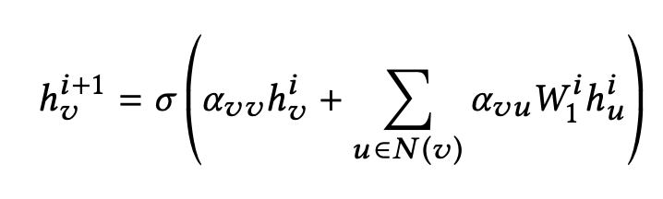


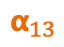


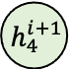
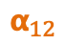
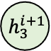
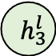
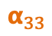
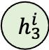

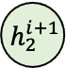
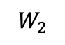
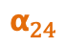
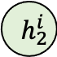



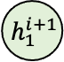
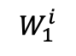
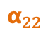
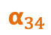
Attributed Graph Embedding
Graph Embedding
Graph attention network (GAT) [Veličković et al. ICLR’18]
Objective function:
$$W_{1}^{i}$$
$$W_{2}$$
$$h_{1}^{i}$$
$$α_{11}$$
$$h_{1}^{i+1}$$
$$h_{1}^{l}$$
$$h_{1}$$
$$α_{12}$$
$$h_{2}^{i}$$
$$α_{22}$$
$$α_{13}$$
$$h_{2}^{i+1}$$
$$h_{2}^{l}$$
$$h_{2}$$
$$h_{3}$$
$$α_{24}$$
…
$$e_{j}$$
$$h_{3}^{i}$$
$$α_{33}$$
$$h_{3}^{i+1}$$
$$h_{3}^{l}$$
$$α_{34}$$
$$h_{4}$$
$$h_{4}^{i}$$
$$h_{4}^{i+1}$$
$$h_{4}^{l}$$
$$α_{44}$$
Input
i-th
(i+1)-th
l-th
Output
Label
Notes:
With the attributed graph, we build a provenance identification model with the graph embedding method.
We use an attention-based graph neural network, named graph attention network.
Given an input graph with node attribute,
The graph attention network would iteratively update a node’s embedding by accumulating the embeddings of its neighbor and itself from the previous layer.
In the end, graph attention network would accumulate the node embeddings to generate a graph embedding. Based on the label, we compute the loss value and back propagate to optimize the network.
To this end, we build a provenance identification model. Once we identify the compilation provenance, we would compile the source code with the same provenance.

Slide 26
Step 2: Code Similarity Computation
Key Insight:
Represent binary code with attributed control flow graph.
Use ranking-based graph triplet-loss network to identify different types of similar code.
Notes:
Then the problem becomes binary code similarity detection.
The first step handles the difference from compilers. In this step, we mainly need to worry about how to identify the binaries with similar source code.
So, we first represent the binary code with attributed control flow graph.
Later, we use ranking-based graph triplet-loss network to identify different types of similar code.

Slide 27
Binary Code to Attributed Graph
Attributed control flow graph
Control flow graph: essential code structure feature
Attributes: syntax features
The problem has become attributed graph similarity problem.
Label ?
int __cdecl do_free_upto(void *, int)
...
jz short loc_81A85E6
Instruction | # of numeric constants
 | # of string constants
 | # of transfer instructions
 | # of calls
 | # of arithmetic instructions
 | # of instructions
Structure | # of children
 | Betweenness centrality
{2, 0, 1, 0, 3, 1, 2, 0}
...
jnz short loc_81A85B6
...
call BIO_free_all
{0, 0, 3, 2, 12, 0, 2, 0.083}
{0, 0, 1, 1, 3, 0, 0, 1, 0.083}
jmp short loc_81A85F2
{0, 0, 1, 0, 1, 0, 1, 0.083}
...
do_free_upto endp
{1, 0, 0, 0, 2, 1, 0, 0}
Assembly code of CVE-2015-1792 compiled with x86-GCC-4.8.4-O0
[CCS’16] Qian Feng, Rundong Zhou, Chengcheng Xu, Yao Cheng, Brian Testa, and Heng Yin. 2016. Scalable Graph-based Bug Search for Firmware Images. In CCS 2016.
Notes:
The control flow graph reserves the code structure, it is an essential representation for code analysis.
For example, this figure shows the Assembly code of a vulnerable binary code. But, only using the control flow graph is not enough because two different codes might share quite similar control flows.
So, we attribute each vertex with syntax features. In total, we extract 8 features, including 6 instruction and 2 structure features. The instruction features include the numeric constants, string constants, transfer instructions, calls, arithmetic instructions, and total instructions. The structure features include the number of children and betweenness centrality value on the control flow graph.
With that, the binary code is converted to an attributed graph.
Now, the code similarity problem has become the attributed graph similarity problem.
We also use graph embedding method, but there is one problem. We don’t have a label for each code.

Slide 28
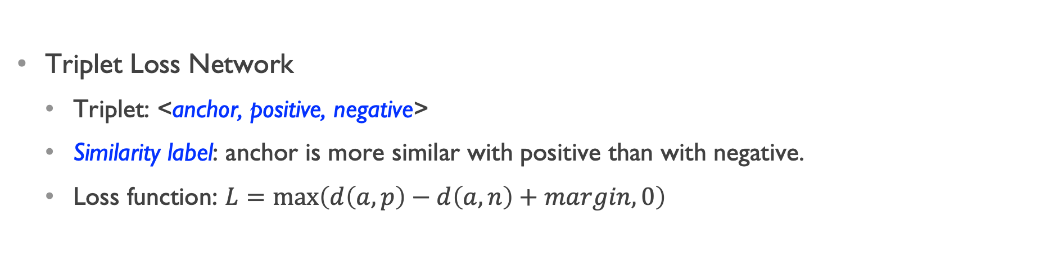
Ranking-Based Triplet Loss Network
Triplet Loss Network
Triplet: <anchor, positive, negative>
Similarity label: anchor is more similar with positive than with negative.
Loss function: $L=\max\left(d\left(a, p\right)−d\left(a, n\right)+margin, 0\right)$
Positive
Positive
Anchor
Anchor
Learning
Negative
Negative
Notes:
So, to solve this label problem, we use a Ranking-Based Triplet Loss Network.
a triplet includes anchor, positive, and negative elements.
The label is on the triplet, not on each element. Basically, the label means the anchor is more similar with the positive than with the negative.
Based on this loss function, the triplet network can generate loss values to supervise the learning process of the graph attention network.
During the learning process, the triplet loss network will learn to put the anchor and positive elements more similar than the anchor and negative elements.

Slide 29
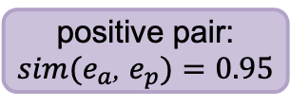
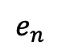
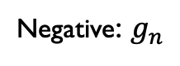
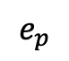
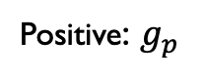
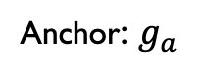
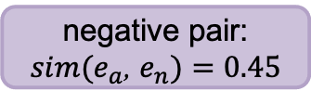
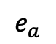
Graph Triplet-Loss Network for Code Similarity
Ranking similar code:
Type-1 > Type-2 > Type-3 > Different
Anchor: $g_{a}$
Positive: $g_{p}$
Negative: $g_{n}$
<1,3,7,0,3,1,0,0>
d
Graph Attention Network
Graph embedding
$$e_{a}$$
$$e_{p}$$
$$e_{n}$$
Triplet Loss
Type-1
positive pair:
$sim(e_{a}$, $e_{p})=0.95$
negative pair:
$sim(e_{a}$, $e_{n})=0.45$
Type-2
Type-3
$L_{i}=max⁡\{sim(e_{a}$, $e_{n})$ - $sim(e_{a}$, $e_{p})+$𝚫, $0\}$
Different
Notes:
Combining them together, we get our graph triplet-loss network.
Taking a triplet of anchor, positive, and negative graphs as input,
the graph attention network generates the graph embedding for each graph.
Then, we use the triplet loss network to compute the loss value.
Next, we back propagate the loss value to the graph attention network and supervise its learning process.
In the end, our graph triplet-loss network would be able to rank different similar code in the high dimensional space like this.

Slide 30
Experiment
 | Software | Compilation Provenance | Similarity Types | # Binaries | # Functions
Train | SNNS-4.2, PostgreSQL-7.2 | Architecture: x86 Compiler: GCC-{4.6.4, 4.8.4, 5.4.1}, LLVM-{3.3, 3.5, 5.0} Optimization: O0 – O3 | Type-1/2/3 | 600 | 493,841
Test | Binutils-{2.25, 2.30}, Coreutils-{8.21, 8.29} |  | Type-1/2/3 | 5,568 | 2,648,627
Total | - | 24 | Type-1/2/3 | 6,168 | 3,142,468
Dataset
6K+ binaries, 3M+ functions
24 compilation provenances
Training and testing use different software
Search 3,000 Type-1/2/3 similar code (1,000 for each)
Report the top-k hit rate, the smaller k the more important
Notes:
Now let’s look at the Experiment.
Here is the dataset we used.
We compiled six software with 24 compilation provenances. That generates over six thousand binaries, and 3 million functions.
The training and testing use different software to avoid the potential bias caused by code sharing in the same software.
We search 3,000 type-1/2/3 similar code.
We report the top-k hit rate, which is the smaller k the more important. Because the security analysists would start investigating from the top. So, the higher we rank the target, the better.

Slide 31
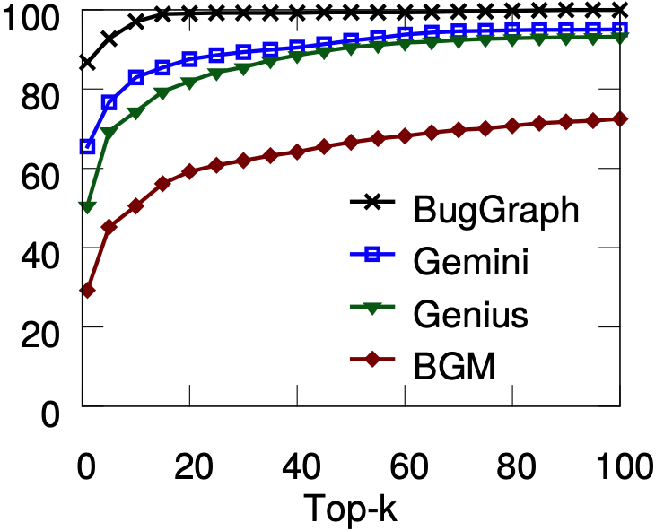
Source-Binary Code Similarity Test
Compilation provenance accuracy:
82% overall accuracy
100%, 100% for architecture, compiler family
96%, 84% for version, and optimization
Type-1 similar code:
E.g., Top-5 hit rate
BugGraph, 93%
Gemini [Xu et al. CCS’17], 77%
Genius [Qian et al. CCS’16], 69%
BGM [Bipartite Graph Matching], 45%
Top-k Hit Rate of Type-1 Similar
Hit rate (%)
Notes:
As for compilation provenance, our method can get 82% overall accuracy.
We get 100% accuracy for architecture and compiler family.
For compiler version and optimization level, we get 96% and 84%.
We compared BugGraph with three works.
Gemini and Genius are two recent works, BGM is a baseline method using bipartite graph matching.
For type-1 similar code, BugGraph gets better result than compared works, especially for smaller k values.

Slide 32
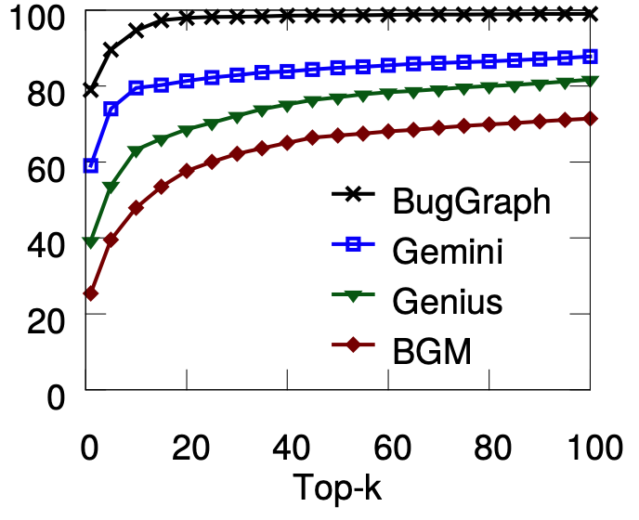
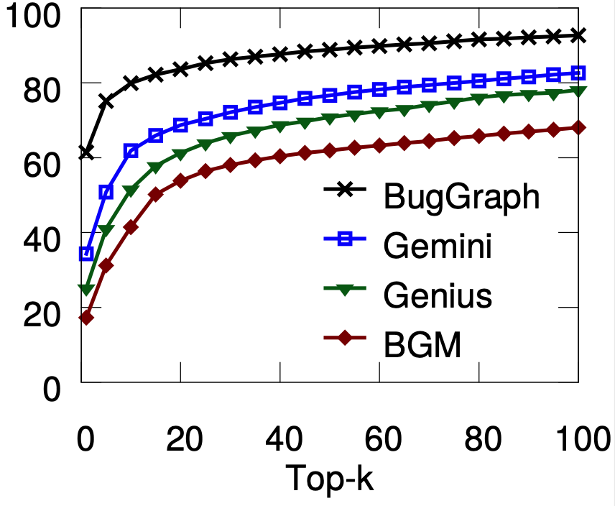
Source-Binary Code Similarity Test
Type-2 Similar Code (top-5 hit rate)
BugGraph, 90%
Gemini, 74%
Genius, 54%
BGM, 40%
Type-3 Similar Code (top-5 hit rate)
BugGraph, 75%
Gemini, 51%
Genius, 41%
BGM, 31%
Top-k Hit Rate of Type-2 Similar
Top-k Hit Rate of Type-3 Similar
Hit rate (%)
Hit rate (%)
Notes:
For type-2 similar code, BugGraph achieves 90% for top-5 hit rate. That is over 16% higher than the rest.
For type-3 similar code, BugGraph achieves 75% for top-5 hit rate. That is over 24% higher than the rest.

Slide 33
Detecting Vulnerabilities from Firmware
Tested firmware: ArcherC9, AD7200, TouchP5, ArcherC2600, ArcherC5200, and ArcherC5400
Vulnerability database: 218 known vulnerable code
Findings:
Identified 140 vulnerable code from 42 unique CVEs.
Old vulnerabilities still exist.
CVE | # Appear | Vulnerability type | CVE | # Appear | Vulnerability type | CVE | # Appear | Vulnerability type
2016-6303 | 5 | out-of-bounds write | 2016-0702 | 5 | side-channel attack | 2015-0206 | 4 | Allow DoS attack
2016-6302 | 5 | Allow DoS attack | 2016-0701 | 2 | Miss required crypto | 2015-0205 | 4 | Allows remote access
2016-2842 | 5 | Out-of-bounds write | 2015-3197 | 3 | Man-in-the-middle | 2015-0204 | 4 | Downgrade attacks
2016-2182 | 5 | Out-of-bounds write | 2015-1794 | 2 | segmentation fault | 2014-8176 | 4 | DoS overflow
2016-2180 | 5 | Out-of-bounds read | 2015-1792 | 4 | Allows DoS attack | 2014-5139 | 3 | NULL pointer dereference
2016-2178 | 5 | Side-channel attack | 2015-1791 | 4 | Double free | 2014-3572 | 4 | Downgrade attacks
2016-2176 | 2 | buffer over-read | 2015-1790 | 4 | NULL pointer dereference | 2014-3567 | 4 | Allow DoS attack
2016-2109 | 2 | memory consumption | 2015-1789 | 4 | Out-of-bounds read | 2014-3511 | 1 | Man-in-the-middle
2016-2105 | 2 | heap memory corruption | 2015-1788 | 4 | Allow DoS attack | 2014-3508 | 1 | information leakage
2016-0799 | 5 | Out-of-bounds read | 2015-0292 | 4 | Integer underflow | 2014-3470 | 1 | NULL pointer dereference
2016-0797 | 3 | Integer overflow | 2015-0288 | 4 | NULL pointer dereference | 2014-0221 | 1 | Allow DoS attack
2016-0705 | 5 | Double free | 2015-0287 | 4 | invalid write operation | 2014-0198 | 1 | NULL pointer dereference
2016-0704 | 4 | Information leakage | 2015-0286 | 4 | invalid read operation | 2014-0195 | 1 | Buffer overflow
2016-0703 | 1 | Man-in-the-middle | 2015-0209 | 4 | Use-after-free | 2013-6449 | 1 | Daemon crash
Notes:
Next, we apply BugGraph to detect the vulnerabilities from real firmware.
We tested six firmware from routers.
We build a vulnerability database with 218 known vulnerable code.
Here are our findings.
We identified 140 vulnerable code from 42 unique vulnerabilities.
This table summarizes the vulnerability, the number of appearances, and vulnerability type
We also find some old vulnerabilities still exist, for example, this one is 9-years-old, and it’s still there.

Slide 34
Summary of BugGraph
New Insight and Method:
BugGraph, first work to identify compilation provenance for code similarity detection.
Improved both accuracy and coverage for less similar code.
Reported to DARPA CHASE
Impact:
BugGraph identified 140 vulnerable code from 6 IoT firmware.
Notes:
In summary,
BugGraph is the first work to identify compilation provenance for code similarity detection. It has significantly improved both accuracy and coverage for less similar code. This project has been reported to the DARPA CHASE program.
BugGraph Identified 140 vulnerable code from 6 IoT firmware.
Any questions?

Slide 35
Agenda
Background
Research Summary
Contribution #1: Binary code vulnerability detection
Contribution #2: Android firmware vulnerability detection
Notes:
Now, let's step into the second part.

Slide 36

Android Firmware Vulnerability Detection
DEFInit: An Analysis of Exposed Android Init Routines
Domain | Project | Graph | Graph Algorithms
Code Vulnerability Detection | DEFInit | Dependency + Control Flow Graph | Graph Traversal
USENIX Security 2021
Notes:
In this part, I will present our recent work on Android firmware vulnerability detection.
Miss Android background.

Slide 37
Android Init
Init Process
Common *NIX process
First process in user-space
Highly-privileged process
Unique in Android
Acts as the system property store
Supports Init Routines
Boot ROM
Init Process
Init Process
Bootloader
Zygote
Kernel
System Server
Notes:
Here is the booting process of Android, there are six major steps, starting from booting the ROM, till starting the system server.
Among them, the Init process is a common process in linux systems. It is the first user-space process launched by the kernel and has high privileges.
Different from Linux, the Android Init acts as the system property store and supports Init routines.

Slide 38
Android Init Routines
System Properties
.rc file
Property Trigger
on property:a=1 && property:b=true
…
start wifitest
…
Init Action
Init Service
service wifitest /bin/wifitest.sh
user root
...
Programs executed by Android Init in response to changes to system properties
Customizable by vendors
Only system (privileged; pre-installed) apps/processes can set system properties
Notes:
The Init routines include action and service. They are defined in resource files with extension rc following the documented Android Init Language.
This is an action example.
It has a trigger with two system properties.
The commands in the action body will be executed when property a equals 1 and property b equals true.
And this is a service example, it calls an executable with optional modifiers. In particular, this service named wifitest will start the script at /bin/wifitest.sh.
Android Init routines can be customized by vendors and only the system apps or processes can set system properties.

Slide 39
Android Init Routines
System App
App
App
Android Framework
Zygote (ART VM)
(lower privilege)
(highly privileged)
Init Routines
Daemons
(highly privileged)
Init
Kernel
Bootloader
Notes:
Let’s look at how Android Init works in more detail. First, Android Init and the routines are running with high privileges. This figure shows the components in the Android ecosystem. The bootloader, kernel, init process, init routines, and daemons are running with high privileges. While the Zygote runtime virtual machine, android framework, along with system and regular apps are with low privileges.

Slide 40
Android Init Routines
(privileged)
System App
App
App
Android Framework
key,value system properties
Zygote (ART VM)
(lower privilege)
(highly privileged)
Init Routines
Daemons
(highly privileged)
Init
Kernel
Bootloader
Notes:
Android allows system apps and Init to exchange information by reading or writing system properties.

Slide 41
Android Init Routines
(privileged)
System App
App
App
Android Framework
key,value system properties
Zygote (ART VM)
(lower privilege)
(highly privileged)
Init Routines
Daemons
(highly privileged)
Init
Kernel
Bootloader
Notes:
Once the properties are written and the corresponding trigger condition is matched, Android Init can execute an Init routine at any point while the system is running.
This allows a system app to easily perform high privileged operations.

Slide 42
Android Init Routines
👍 Unique hardware features, diagnostics, docking, mounting, etc., that cannot be done
directly in a privileged app
(privileged)
System App
App
App
Android Framework
key,value system properties
Zygote (ART VM)
(lower privilege)
(highly privileged)
Init Routines
Daemons
(highly privileged)
Init
Kernel
Bootloader
Notes:
The device vendors can configure and extend the behaviors of Android Init by defining custom Init routines.
This would benefit vendors as they can leverage the Init routines to easily adapt to the unique hardware features, diagnostics, docking, and mounting, that can not be done directly in a privileged app.

Slide 43

Android Init Routines
👎 Improper access control in privileged apps can expose Init Routines to unprivileged apps, resulting in crossing security boundaries!
(privileged)
(unprivileged)
System App
App
App
Android Framework
key,value system properties
Zygote (ART VM)
(lower privilege)
(highly privileged)
Init Routines
Daemons
(highly privileged)
Init
Kernel
Bootloader
Notes:
However, if the privileged apps have improper access control, this can expose Init Routines to unprivileged apps. This can lead to crossing security boundaries!
As Android Init is highly privileged, this would usually cause serious security issues.

Slide 44
What We Found
Numerous zero-day privilege-escalation vulnerabilities due to custom (added by vendors) Init routines that are exposed to unprivileged apps!
Notes:
So, what have we found? We have found numerous zero-day privilege-escalation vulnerabilities due to custom Init Routines that are exposed to unprivileged apps!

Slide 45
Real-World Example
Attack App (unprivileged)
Init Routines (.rc file)
void exploit() {
v0 = new Intent(“wifitest”);
sendBroadcast(v0);
…
}
on property:a=1 && property:b=true
…
start wifitest
…
service wifitest /bin/wifitest.sh
user root
...
3
1
2
System App (privileged)
4
void onReceive(...) {
...
setprop(“a”, “1”);
setprop(“b”, “true”);
…
}
/bin/wifitest.sh
…
setenforce 0
...
Disable SELinux!
Notes:
Let me show you a real example detected by our system.
We assume an attacker controlled third-party app has been installed on an Android device. This attack app would broadcast a message.
This message is received by a privileged system app that registered to receive that. Once received, the privileged app sets the system properties "a" to "1" and "b" to "true".
These two system properties trigger the monitored Init action. Later, this action will start a service named, wifitest.
This service will execute the referred script.
Finally, the script would execute the setenforce 0 command.
This command disables SELinux which disables the primary system defenses, including access control enforcement between processes on the system.

Slide 46
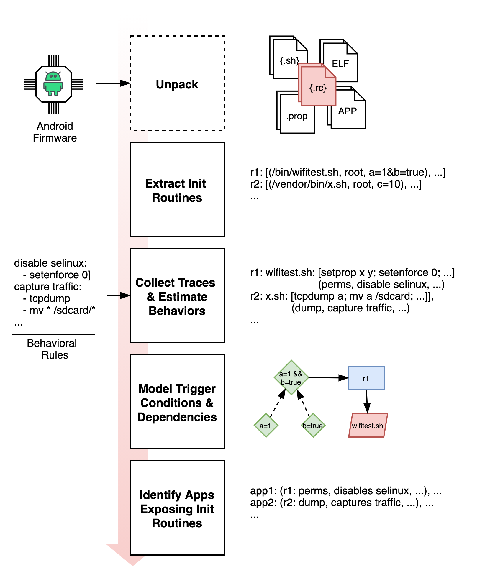
Automated Discovery with DEFInit
Automated system to identify exposed security-sensitive Init routines, their behaviors, and the apps exposing them
First study on the security impact of customized Android Init routines
89 High-Impact Zero-Days
Disabling SELinux, sniffing network traffic, reading system logs, recording screen, etc.
Notes:
To find these vulnerabilities,
we designed DEFInit, an automated system to identify exposed security sensitive Init routines, their behaviors, and the apps exposing them.
We made the first study on the security impact of customized Android Init routines.
To this end, we have confirmed 89 high-impact zero-day vulnerabilities, including disabling SELinux, sniffing network traffic, reading system logs, recording screen, and others.
In the following, I would discuss the details of the five steps shown in this figure.

Slide 47
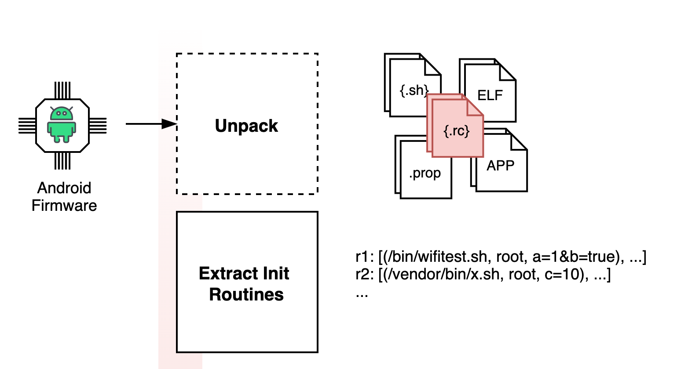
Unpack and Extract Init Routine Definitions
Challenges:
Multiple firmware file formats
Dynamically load and process .rc files
Import Init sections defined in other files
Service and action definitions are polymorphic
Solutions:
Integrate multiple firmware file format unpackers
Start parsing at the root /init.rc file
Nest into imported files in depth-first order
Keep track of merge or override options
Notes:
Given an Android firmware, we first unpack it and extract Init routine definitions.
There are various challenges to do that. The firmware has multiple file formatts. Init dynamically loads and processes .rc files in the presence of extra sources of information, such as system properties preloaded at boot time.
Init .rc files can also import Init sections defined in other files. The service and action definitions are polymorphic, for example, a service can override its parent definition by using an override modifier.
To address these challenges, we propose one solution to each challenge.
In particular, we integrate different types of firmware file format unpackers. We start parsing at the root /init.rc file.
Then, we nest into the imported files in depth-first order to mimic the dynamic behaviors of Init. We also keep track of the merge or override options to handle the polymorphic definitions.

Slide 48
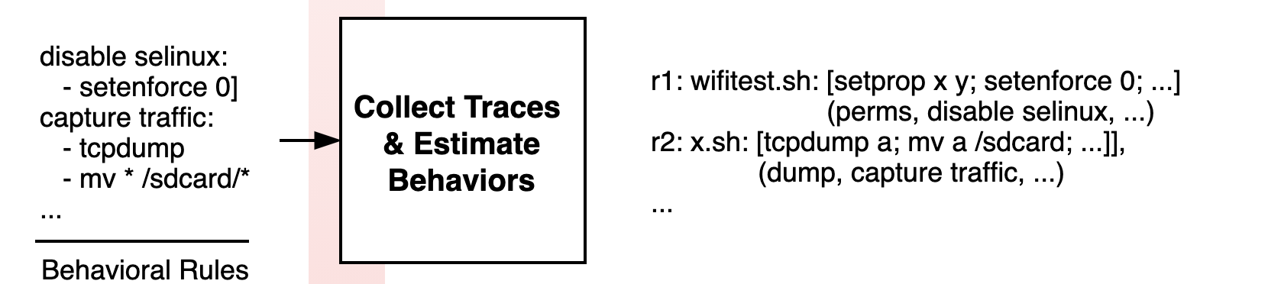
Estimate Behaviors of Init Routines
Challenges:
Estimating security-relevant behavior of arbitrary programs
Multiple formats: Init commands, ELF binaries, Shell Scripts
Notes:
The next step is collecting traces and estimating behaviors of Init routines.
There are two major challenges, the first one is how to estimate security-relevant behavior of arbitrary programs. The second challenge is from the multiple formats of the program executed by Init routines, including Init commands, ELF binaries, and shell scripts.

Slide 49
Estimate Behaviors of Init Routines
Solutions:
Extract code traces
ELF binaries → collect static traces of called APIs along CFG paths in DFS order
Shell scripts → collect code traces by dry-running them in a custom shell tracer
...
...
A = “/data/tmp.log”
C = “test”
logcat * > A
B = “/sdcard”
print(C)
mv(A, B)
...
Notes:
To solve these challenges, we first extract the program’s code traces (including hardcoded parameter values). For ELF binaries, we collect static traces of called APIs on the control flow graph in a depth-first order. For shell scripts, we developed a custom shell tracer to dry-run them to collect code traces.
This figure shows a simplified control flow graph.

Slide 50
Estimate Behaviors of Init Routines
Solutions:
Extract code traces
ELF binaries → collect static traces of called APIs along CFG paths in DFS order
Shell scripts → collect code traces by dry-running them in a custom shell tracer
Match interesting trace sequences using static rules
...
...
Read Logcat Logs:
logcat * (-f|>) $sdcard/*
| logcat * (-f|>) *
(mv|cp) * $sdcard/*
A = “/data/tmp.log”
C = “test”
logcat * > A
B = “/sdcard”
print(C)
mv(A, B)
...
Notes:
And we would collect the highlighted nodes as the code traces following a group of predefined security sensitive commands and APIs.
Then, we would match the interesting trace sequences using static rules. For this example, it will match the rule of “reading logcat logs”. It tells us this program is highly likely to move system logs to sdcard, that can be further read by a third-party app.

Slide 51
Model Trigger Conditions
Init Routines (.rc file)
Challenges
Multiple interdependencies between Init actions, services, Android commands, and APIs
on property:a=1 && property:b=true
…
start wifitest
…
service wifitest /bin/wifitest.sh
user root
...
3
4
/bin/wifitest.sh
…
setenforce 0
...
Notes:
Next, we model the trigger conditions of Init routines. The challenge here is the multiple interdependencies between Init actions, services, Android commands and APIs. For this example, the action requires two properties to be triggered. It will start service wifitest following arrow 3, which will execute the shell script afterwards.

Slide 52
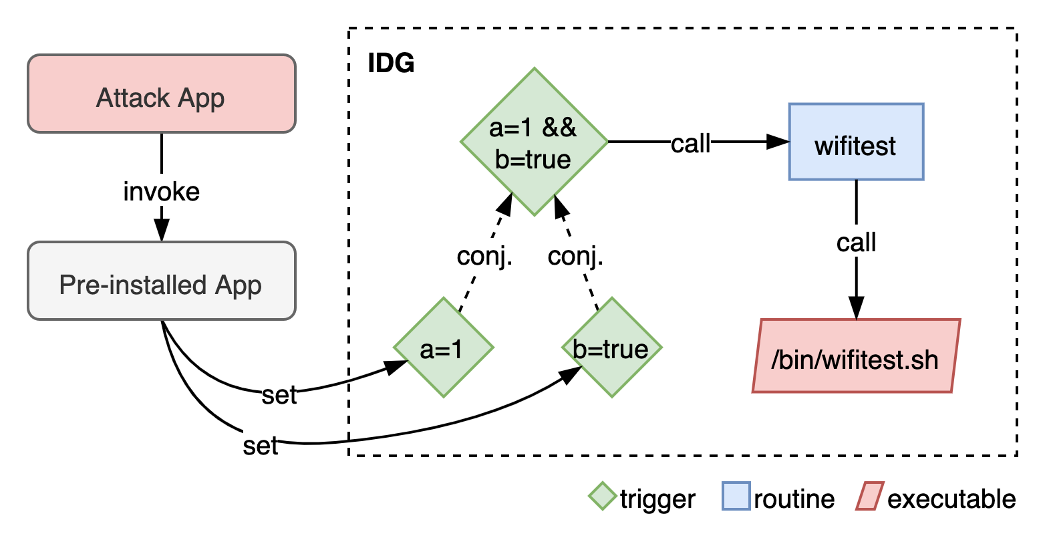
Model Trigger Conditions
Challenges
Multiple interdependencies between Init actions, services, Android commands, and APIs
Solutions
A novel graph structure called an Init Dependency Graph (IDG)
Notes:
To capture these dependencies, we design a novel graph structure, called Init Dependency Graph, IDG. It is a directed heterogeneous graph. In an IDG, nodes represent Init triggers, services, and programs called by routines. Edges denote call edges between them and conjunction relationships between conjuncts in a composite property trigger. The previous example will be modeled like this. Using an IDG, we can efficiently model the relationships between different objects.
Explain the example.

Slide 53

Identify Exposed Routines and Behaviors
Challenges
Identifying system property call sites
Resolving argument values
Detecting if a call site is exposed to unprivileged apps
Solutions
Context- and flow-sensitive property key and value extraction
Reachability query from IPC entry points to call sites on control-flow graphs
Notes:
In the last step, we identify the exposed routines and their behaviors.
This requires identifying app call sites that invoke APIs setting system properties, and resolving the corresponding argument values. We also need to detect if a call site is exposed to unprivileged apps.
To solve these challenges, we developed a context- and flow-sensitive property key and value extraction technique. It can accurately identify the read or written property keys and the mapping between each property key and its corresponding value. We then identify the exposed routines by querying the reachability from IPC entry points to call sites on control-flow graphs.

Slide 54
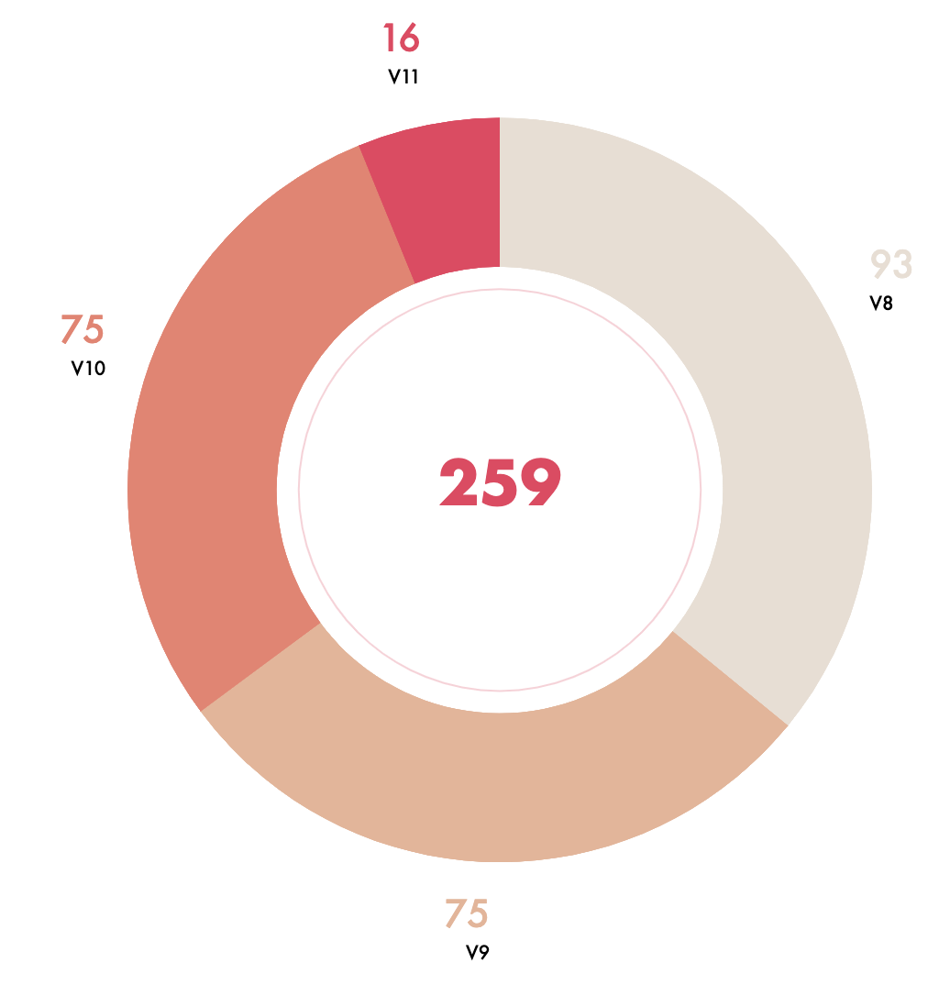
Analyzed Firmware Dataset
259 Android 8 -- 11 firmware
21 top vendors worldwide
65k system apps
262 per firmware (average)
Notes:
We performed a large-scale study on 259 stock Android firmware images from 8 to 11 covering 21 top vendors worldwide.
These images contained a total of 65k system apps with an average of 262 per firmware.

Slide 55
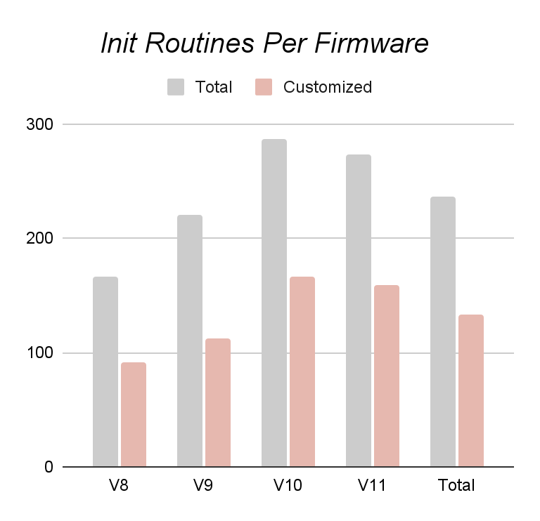
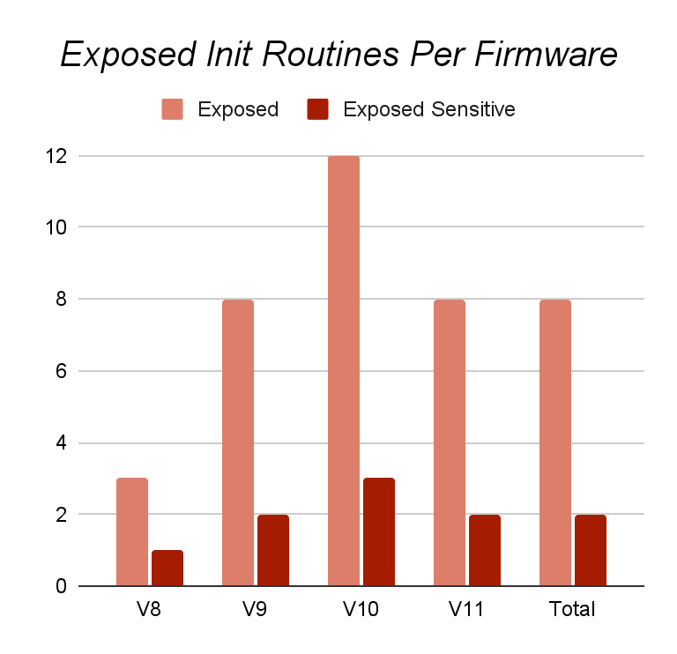
Identified Init Routines
223 routines per firmware
66% custom (added by vendors)
8 exposed routines per firmware
2 sensitive exposed routines per firmware
All custom!
Notes:
Now let’s look at the identified init routines.
This chart shows the identified init routines per firmware based on Android versions. In summary, there are 223 Init routines per firmware. 66% of them are custom. This shows the great extent to which vendors customize the Init routines to introduce new functionalities.
The chart on the right shows the exposed Init routines per firmware. On the average, each firmware exposed 8 routines, 2 of them are security-sensitive. All of them are custom by the vendors.

Slide 56
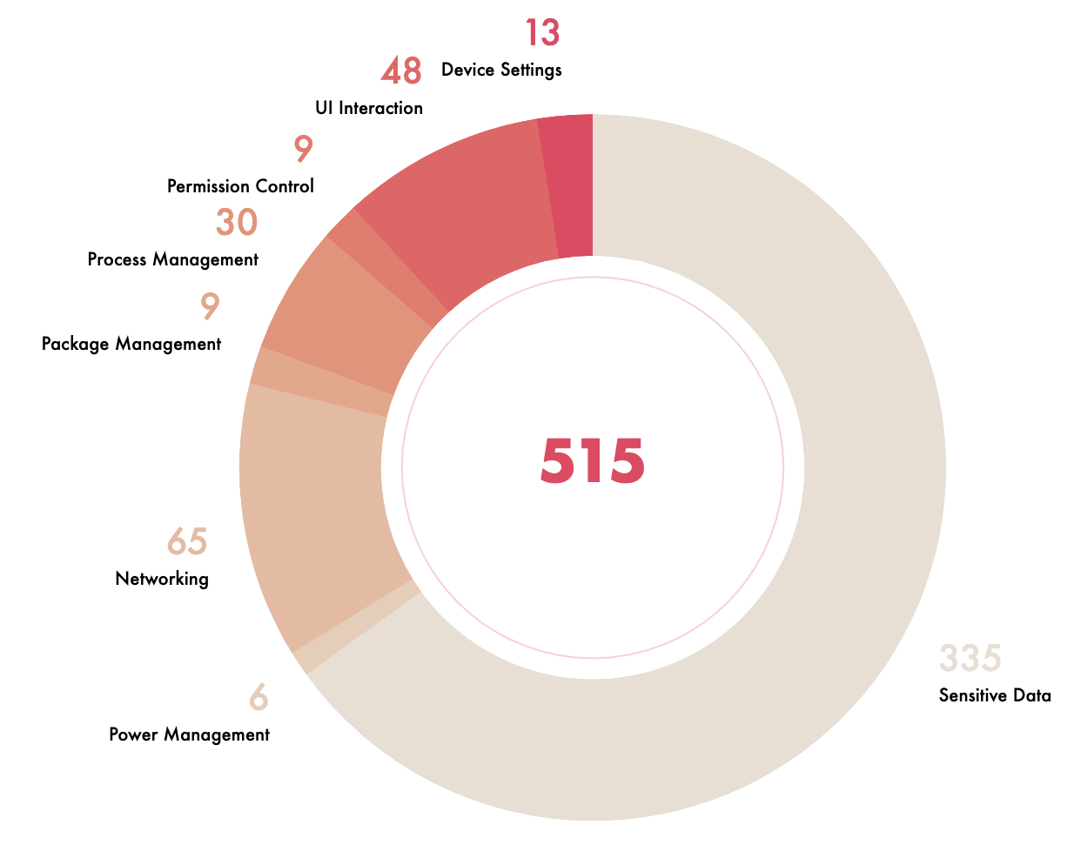
Exposed Behaviors
515 exposed sensitive functionalities
430 unique routines
173 unique apps
101 firmware
13 vendors
Notes:
This chart shows the breakdown of the identified exposed behaviors, grouped by behavior category. There are 515 exposed sensitive functionalities, which are from 430 unique Init routines. They cover 173 unique apps, spanning 101 firmware from 13 vendors.

Slide 57
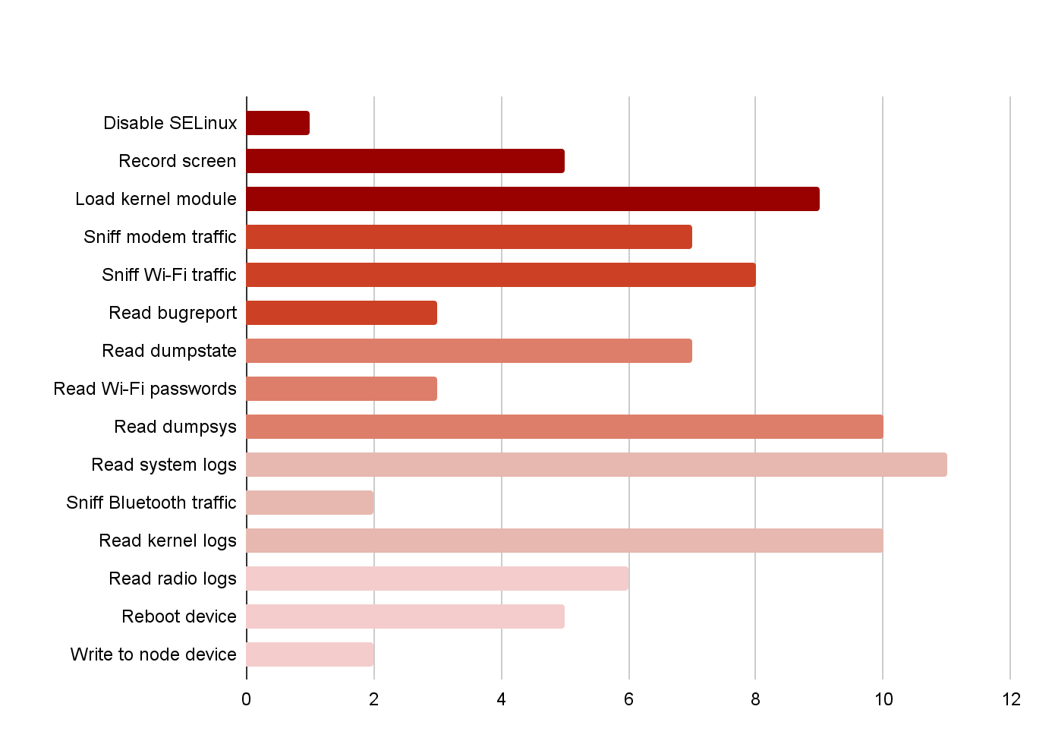
Discovered Zero-Day Vulnerabilities
Verified 89 0-day vulnerabilities
34 unique apps
30 firmware
6 vendors
Developed + Tested 59 PoCs
49 confirmed by 3 vendors so far
CVE-2020-11164 (published by vendor)
https://nvd.nist.gov/vuln/detail/CVE-2020-11164
Notes:
We further manually inspected the routines to verify their potential security impact. This chart summarizes the outcome.
So far, we have verified 89 vulnerabilities in 34 unique apps from 30 firmware of 6 vendors.
We have developed and tested 59 proof-of-concepts.
Three vendors have confirmed our findings (covering 49 vulnerabilities in 11 firmware). Our disclosure process is still ongoing.

Slide 58

Impact of Discovered Vulnerabilities
Disable system-wide Mandatory Access Control
Execute arbitrary code with high privileges
Spy on screen content and user activity
Spy on content of sent/received SMS messages and Calls
Capture data transmitted using Wi-Fi and Bluetooth
Capture an extensive amount of PII from numerous sources
Capture information to attack other processes (mmap, open files, etc.)
Prevent meaningful usage of the device (persistent DoS attack)
Access stored Wi-Fi passwords
...
Courtesy: thehackernews.com
Notes:
The discovered vulnerabilities have high impact. Here we list some of the impacts, including disabling system-wide mandatory access control, executing arbitrary code with high privileges, spying on screen content and user activity, and others.

Slide 59
Summary of DEFInit
DEFInit:
Systematically studied security impact of Android Init routines
Novel study and automated analysis
Various high-impact zero-days in Android 8 -- 11 devices
Findings:
Tested 259 firmware from top-21 Android vendors.
Found 515 exposed Init routines with sensitive behaviors (all customized).
Manually verified 89 0-day vulnerabilities.
Notes:
In conclusion, we systematically studied the security impact of Android Init routines. We performed an automated and practical analysis.
We have identified various high-impact zero-days in Android 8 -- 11 devices.
Findings

Slide 60

Graph-Centric Security, Learning, and Computing (Graph) Lab @ UNT
Security
Code vulnerability detection
DEFInit [Security’21]
BugGraph [AsiaCCS’21]
Vestige [ACNS’21]
Cyber threat detection
NestedGNN [ICC’22]
CyberGraph [RAID’20]
High-Performance Computing (HPC)
Graph AI
HPC for graph algorithms
Aquila [HPDC’20]
iSpan [SC’18]
Graph AI explanation
Illuminati [EuroS&P’22]
HPC for graph AI
TLPGNN [HPDC’22]
Notes:
For security, we mainly work on
1. code vulnerability
2. cyber threat detection
For graph algorithms, we also look at the explanation to GNN models, especially for security applications.
For HPC, we mainly work on
1. HPC for GNN
2. HPC for graph algorithms

Slide 61
Acknowledgement to Students @ Graph Lab
Wang Feng (PhD student)
Krishna Sai Ujwal (PhD student)
Boxiang Guo (MS student)
Krishna Tiwadi (Undergraduate)
Vedansh Tembhre (Undergraduate)
Avik Malladi (UNT TAMS, High School)
Lillian Wang (UNT TAMS, High School)
Chotepong Victor Tangton (UNT TAMS, High School)
Donavon Zhang (UNT TAMS, High School)
Sua Cho (UNT TAMS, High School)
Notes:
Many thanks to the talented students at our graph lab.

Slide 62







Acknowledgement to Collaborators
Dr. H. Howie Huang
…
Dr. Hang Liu
…
Dr. Angelos Stavrou
Dr. Peng Gao
Dr. Binghui Wang
Dr. Alexandru G. Bardas
Dr. Mohamed Elsabagh
Dr. Ryan Johnson
Dr. Pradeep Kumar
Notes:
Many thanks to my collaborators.

Slide 63
Graph-Centric Security, Learning, and Computing (Graph) Lab @ UNT
Security
Code vulnerability detection
DEFInit [Security’21]
BugGraph [AsiaCCS’21]
Vestige [ACNS’21]
Cyber threat detection
NestedGNN [ICC’22]
CyberGraph [RAID’20]
HPC
Graph Algorithm/Learning
HPC for graph algorithms
Aquila [HPDC’20]
iSpan [SC’18]
GNN explanation for security applications
Illuminati [EuroS&P’22]
HPC for GNN
TLPGNN [HPDC’22]
Notes:
Thank you for listening.
I would be happy to take your questions now.

Slide 64
Graph Lab @ UNT
Security
Code vulnerability detection
DEFInit [Security’21]
BugGraph [AsiaCCS’21]
Vestige [ACNS’21]
Cyber threat detection
NestedGNN [ICC’22]
CyberGraph [RAID’20]
HPC
Graph Algorithm/Learning
HPC for graph algorithms
Aquila [HPDC’20]
iSpan [SC’18]
GNN explanation for security applications
Illuminati [EuroS&P’22]
HPC for GNN
TLPGNN [HPDC’22]
Notes:
Thank you for listening.
I would be happy to take your questions now.

